Slide 1

Title
HR Analytics - Predict Employee Attrition

Slide 2
Executive Summary (1/2)
Attrition, which represents the turnover of employees across all departments and levels of an organization, has several downsides and negative impacts
These effects can be significant and wide-ranging, affecting the company's performance and its ability to achieve its strategic objectives
Some of the key disadvantages of having a high attrition rate in a company include the cost of recruitment and onboarding, loss of knowledge and expertise, productivity disruption, decreased team cohesion, impact on customer relationships, delayed project and goals, amongst many others
Predictive analytics allows HR to take the best decisions that reduce attrition rate
Make decisions based on statistical data rather than speculation to address real turnover drivers
Identify systemic issues affecting engagement and attrition, facilitating company-wide adjustments rather than individual-level changes
To address this issue in your company, a predictive analytics model was developed to identify potential employee attrition
The Random Forest model emerged as the most effective, balancing accuracy and interpretability
The confusion matrix shows a significant number of true positives and true negatives, with very few false positives and false negatives, reflecting the model's reliability
The most important features resulted in the model are monthly income, overtime, age and years at the company

Slide 3
Executive Summary (2/2)
Regarding the predictive model, who’s really leaving your Company?
Younger employees are more likely to leave the company than others
Single employees are more likely to quit their jobs in comparison to married or divorced employees, boosting an attrition rate of 26%, while married and divorced employees boost 12% and 10%, respectively
Sales representatives have the highest attrition rate, followed by Laboratory Technicians, Human Resources (23%) and Sales Executives (17%). All of these are well above your average attrition rate of 16%
Employees who work overtime have a higher attrition rate (31%) in comparison to those who don’t work overtime (10%)
The employees who leave the company have a significantly lower monthly income than those who don’t leave
Employees who live closer to their work places are less likely to quit their jobs
Employees who travel the most for work, also have higher attrition levels
New employees are more likely to quit their jobs, when comparing to employees that have been working in the company for more than a couple of years. This trend is particularly steeper in the first 2 years working in the company
Therefore, we suggest three strategic priorities to reduce attrition rate
For employee profile, it is important to implement mentorship and career development programs; promote a culture of ongoing learning; provide career advancement opportunities to retain experienced workers and act preventively before they reach the average age of leaving; conducting regular satisfaction surveys
Regarding monthly income feature, we recommend salaries according to the industry benchmarks; improve Incentives and bonuses; implement clear career planning and salary revision, as well as retirement savings account
Regarding the work life balance, it is important to implement flexible work hours and support effective remote work; hire additional staff and redistribute workloads among employees; establish a predetermined high rate of pay for overtime work; provide transportation assistance and create new satellite offices near employee housing clusters

Slide 4



Three strategic priorities to reduce attrition rate
Dissatisfaction strongly expressed in young and single employees
Income inequality strongly marked dissatisfaction, specially among the lowest paid workers
Monthly Income
Work-life
Balance
Overtime can lead to burnout and dissatisfaction, specially in employees that work away from home
Employee
Profile
Issues
Implement mentorship and career development programs
Act preventively before they reach the average age of leaving, conducting regular satisfaction surveys
Promote a culture of ongoing learning
Provide career advancement opportunities to retain experienced workers
Years of Service Incentives
Salaries according to the industry benchmarks
Medical Insurance and Education incentives
Improve Incentives and Bonuses
Clear Career Planning and Salary Revision
Retirement Savings Account
Establish a predetermined high rate of pay for overtime work
Implement flexible work hours and support effective remote work
Hire additional staff and redistribute workloads among employees
Satellite offices near employee housing clusters
Conduct regular exit surveys
Provide transportation assistance
Suggestions

Slide 5
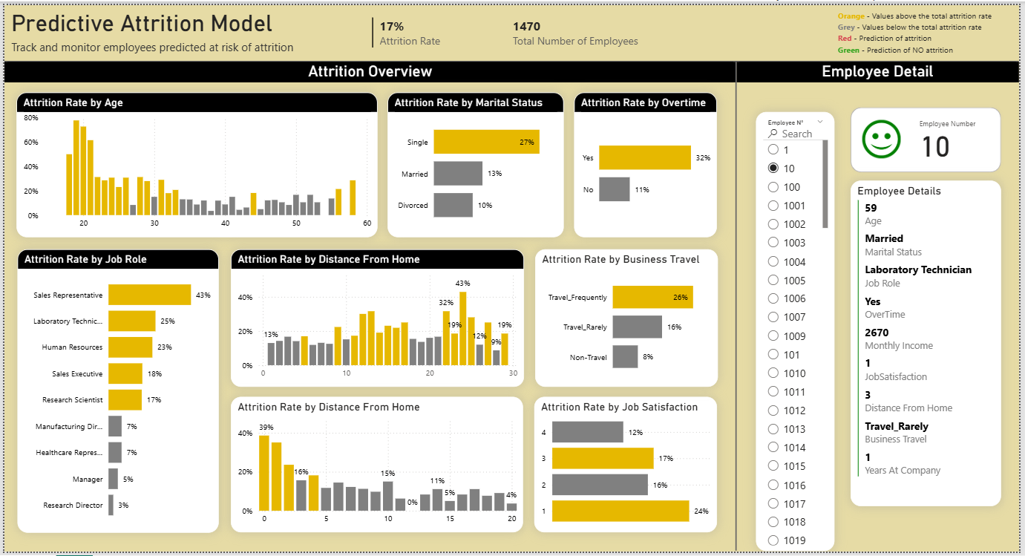
Integrating Predictive Attrition Model into HR Dashboard
Empower HR with actionable insights to proactively address potential employee attrition.
Real-Time Monitoring: Track and monitor employees predicted at risk of attrition.
Prioritization: Focus on high-risk individuals for retention interventions.
Trends & Analysis: Visualize attrition patterns over time to inform strategic HR decisions.
Custom Alerts: Set notifications for flagged employees to take timely action.

Slide 6
Integrating Predictive Attrition Model into HR Dashboard (Explained)
Attrition Overview: For the most important features, in orange is identified where the attrition rate are higher than the overall attrition rate of the company (17%)
Employee Details: According to the predictive model:
- If Red the employee is in risk of attrition
- If Green the employee is not in risk of attrition

